Slide 1

Machine Learning
ICT-
By-
Dr. Jesmin Akhter
Professor
Institute of Information Technology
Jahangirnagar University

Slide 2
Contents
The course will mainly cover the following topics:
Ensemble Learning
Unsupervised Learning
Clustering Fundamentals
Hierarchical Clustering
………………………..
Neural Networks and Deep Learning
Notes:
More Supervised - Adaboost Gradient boosting Xgboost

Slide 3
The XGBoost Algorithm
The XGBoost algorithm follows a supervised learning method that utilizes gradient boosting to create an ensemble of multiple decision trees.
During the training process, the algorithm starts with an initial prediction and computes the residuals based on the predicted values and the observed values.
The first step in XGBoost is to make the first guess, that is, to determine the base score. The base score is usually set at 0.5. So the initial prediction values are 0.5. Then the residuals are obtained by subtracting 0.5 from the actual y values
It then creates other decision trees using a similarity score for the residuals, which are then used to generate the output values for each leaf.
This process is repeated either until the residuals stop reducing or for a specified number of times. Each subsequent tree learns from the previous ones.

Slide 4
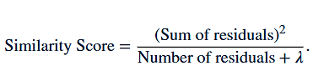
XGBoost
Below are the formulas which help in building the XGBoost tree for Regression.
Step 1: Initialize the prediction of target y and compute the residual. Average value of y is good initial value. You may use 0.5
Step 2: Calculate the similarity scores, it helps in growing the tree.
Step 3: Calculate the gain to determine how to split the data.
Gain = Left tree (similarity score) + Right (similarity score) - Root (similarity score)
Step 4: After the tree with the highest gain score is determined, the pruning process is started. During the pruning process, the "gamma" hyperparameter is used as a metric. if Gain Score- gamma < 0, the branch is pruned. If the result is a positive number then do not prune and again subtract gamma from the next Gain value way up the tree.
As gamma increases, the most valuable branches remain on the tree and This pruning helps prevent overfitting. Pruning is done from the bottom to the top. If the bottom branch is not pruned, the upper branches are not examined.

Slide 5
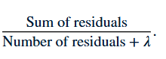
XGBoost
Step 5: Calculate output value for the remaining leaves
Output value =
Step 6: Calculate new predictions using output values
New Prediction = First Prediction + (Learning Rate)* output values
Step 7: Calculate new residual using new Prediction
Step 8: Repeat steps 2 through 7
The residuals continue to decrease and the predicted y gets closer to the actual y

Slide 6
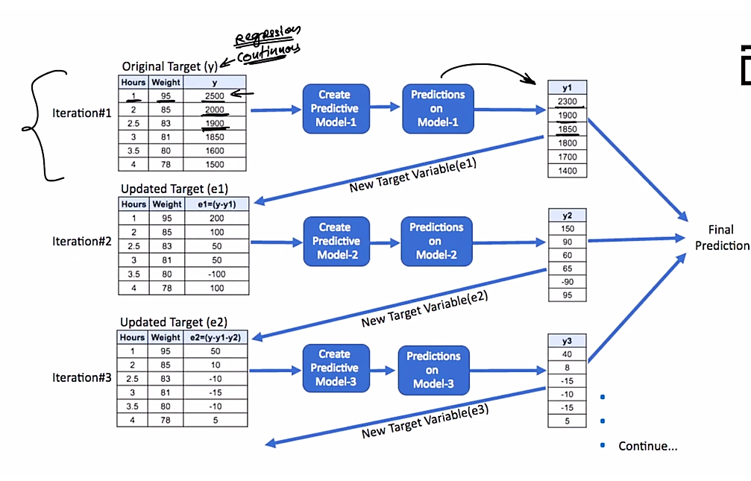
What XG Boost tries to do?
It tries to attack gradient directly
Gradient- direction of the error
Error-Differences between target and predicted value

Slide 7
XGBoost
The loss function is also responsible for analyzing the complexity of the model, and if the model becomes more complex there becomes a need to penalize it and this can be done using Regularization. It penalizes more complex models through both LASSO (L1) and Ridge (L2) regularization to prevent overfitting. The ultimate goal is to find simple and accurate models. Regularization parameters are as follows:
gamma: minimum reduction of loss allowed for a split to occur. Higher the gamma, fewer the splits. alpha: L1 regularization on leaf weights, larger the value, more will be the regularization, which causes many leaf weights in the base learner to go to 0.
lambda: L2 regularization on leaf weights, this is smoother than L1 and causes leaf weights to smoothly decrease, unlike L1, which enforces strong constraints on leaf weights.

Slide 8
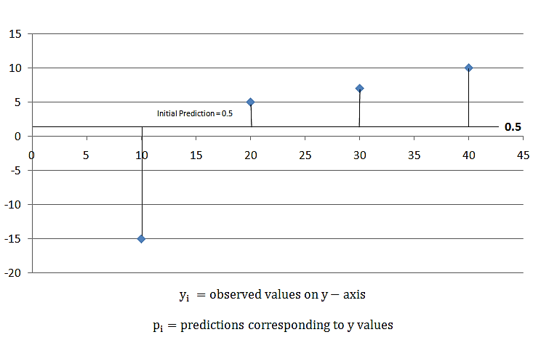
XGBoost
Note: If the value of lambda is greater than 0, it results in more pruning by shrinking the similarity scores and it results in smaller output values for the leaves. Let’s see a part of mathematics involved in finding the suitable output value to minimize the loss function For classification and regression, XGBoost starts with an initial prediction usually 0.5, as shown in the below diagram.

Slide 9
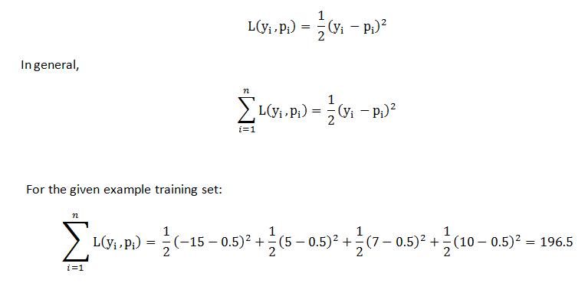
XGBoost
To find how good the prediction is, calculate the Loss function, by using the formula,
For the given example, it came out to be 196.5. Later, we can apply this loss function and compare the results, and check if predictions are improving or not. XGBoost uses those loss function to build trees by minimizing the below equation:

Slide 10
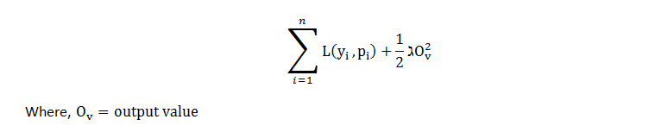
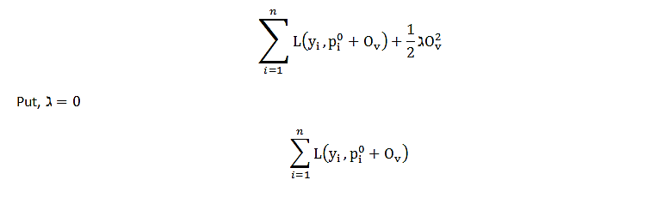
The first part of the equation is the loss function and the second part of the equation is the regularization term and the ultimate goal is to minimize the whole equation. For optimizing output value for the first tree, we write the equation as follows, replace p(i) with the initial predictions and output value and let lambda = 0 for simpler calculations. Now the equation looks like,

Slide 11
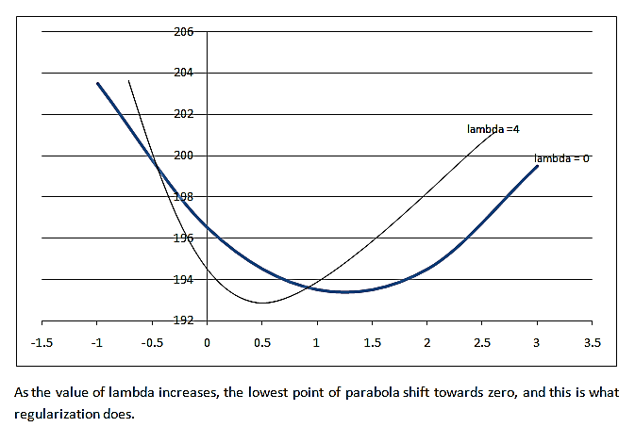
XGBoost
The loss function for initial prediction was calculated before, which came out to be 196.5. So, for output value = 0, loss function = 196.5. Similarly, if we plot the point for output value = -1, loss function = 203.5 and for output value = +1, loss function = 193.5, and so on for other output values and, if we plot this in the graph. we get a parabola like structure. This is the plot for the equation as a function of output values.

Slide 12

If lambda = 0, the optimal output value is at the bottom of the parabola where the derivative is zero. XGBoost uses Second-Order Taylor Approximation for both classification and regression. The loss function containing output values can be approximated as follows:
The first part is Loss Function, the second part includes the first derivative of the loss function and the third part includes the second derivative of the loss function. The first derivative is related to Gradient Descent, so here XGBoost uses ‘g’ to represent the first derivative and the second derivative is related to Hessian, so it is represented by ‘h’ in XGBoost.

Slide 13
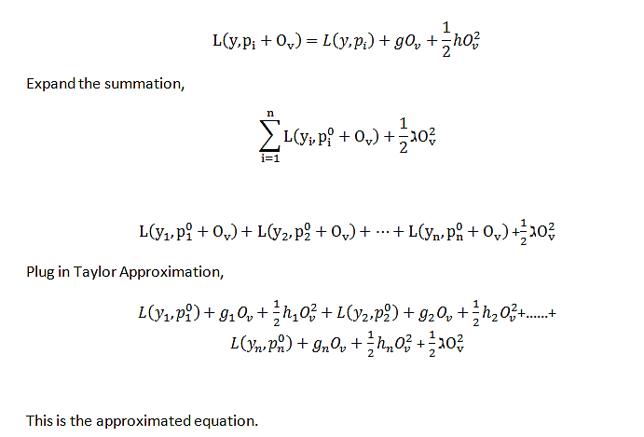
Plugging the same in the equation:

Slide 14
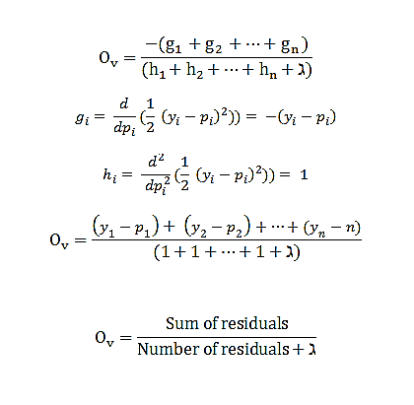
Remove the terms that do not contain the output value term, now minimize the remaining function by following steps:
Take the derivative w.r.t output value.
Set derivative equals 0 (solving for the lowest point in parabola)
Solve for the output value.
g(i) = negative residuals
h(i) = number of residuals
This is the output value formula for XGBoost in Regression. It gives the x-axis coordinate for the lowest point in the parabola.

Slide 15
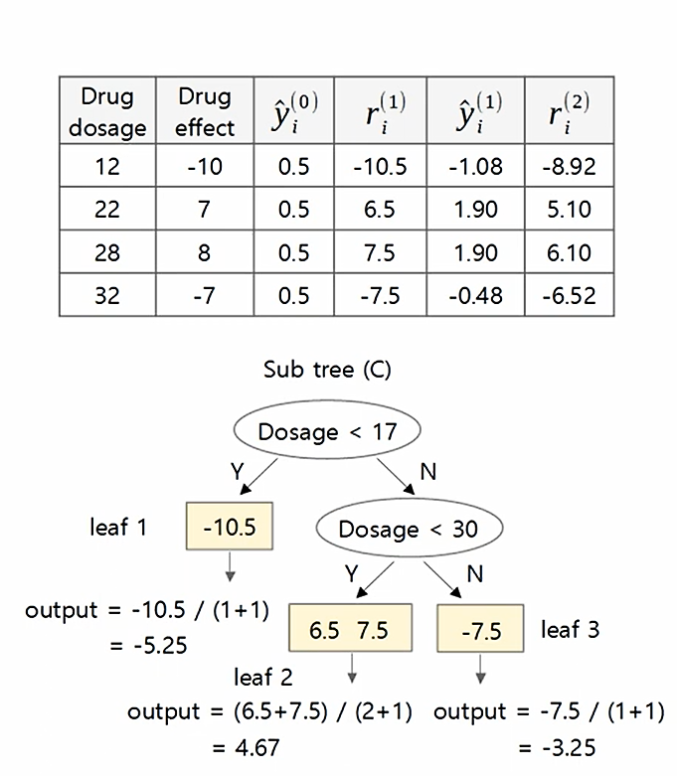
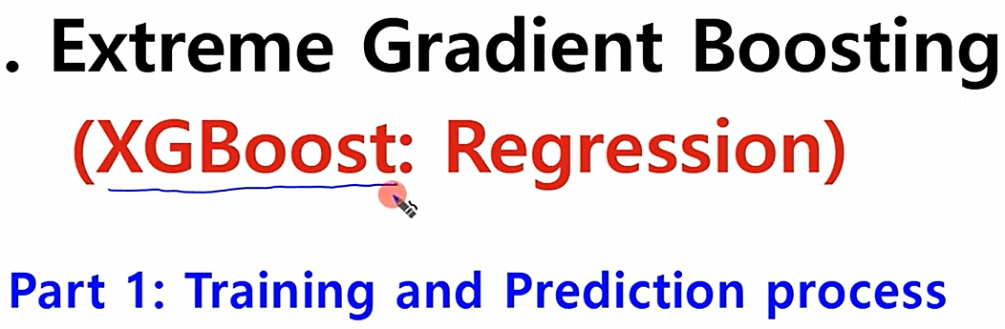
Solved problem 01(Regression)

Slide 16
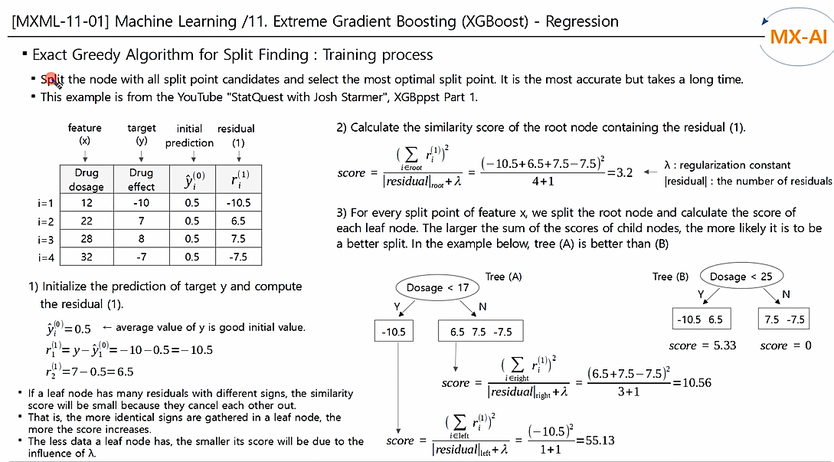
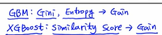
Solved problem 01

Slide 17
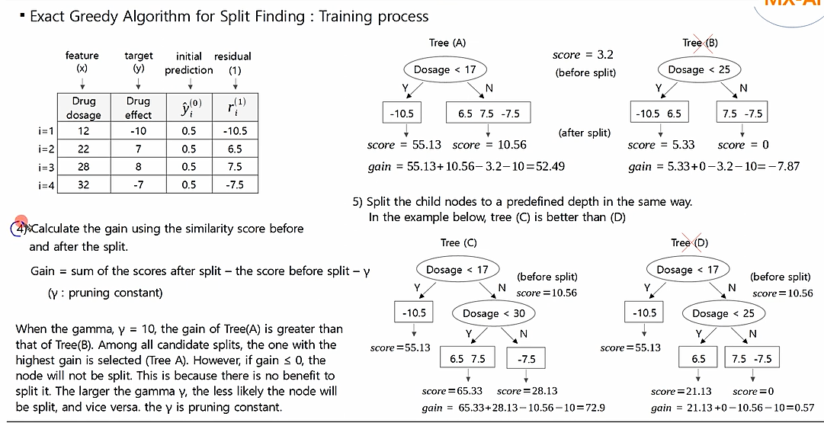
Solved problem 01
Notes:
https://www.youtube.com/watch?v=mA3uJyMB4XU

Slide 18
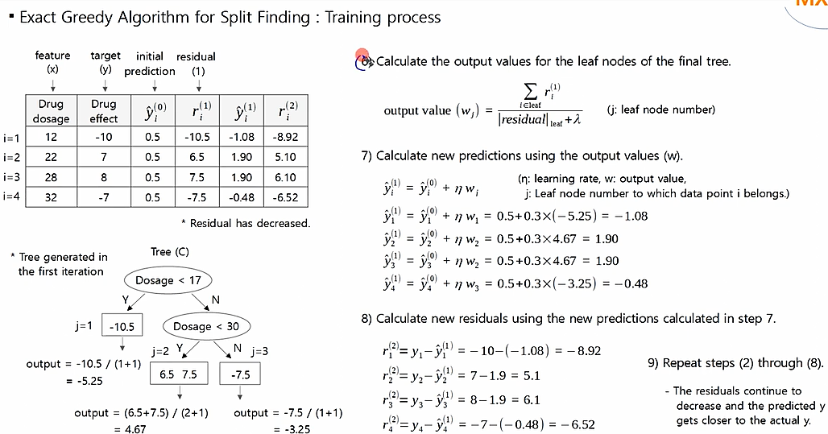
Solved problem 01
-3.75=
-0.625
(-0.625)=
-6.375
-3.75

Slide 19
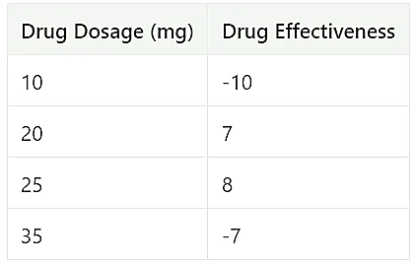
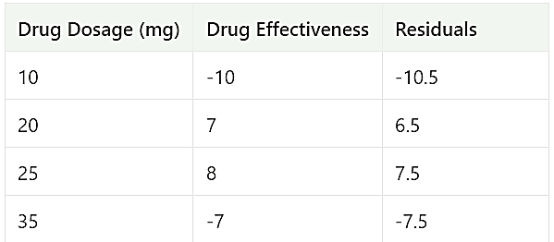
Solved problem 02(Regression)
XGBoost Regression Practical Example
Step1: Make Initial Prediction
The prediction can be anything, but by default, it is 0.5, regardless of whether you are using XGBoost for regression or classification
Step2: We Calculate The Residuals (Observed-Predicted)
For this example Predicted value = 0.5, so residuals are listed below

Slide 20
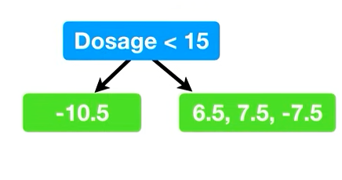
Solved problem 02(Regression)
Step3: This Step Can Be Done In The Three Sub-Steps
Part(a): we try different threshold values to construct the tree
Part(b): we calculate the similarity score
Part(c): we compute the gain, any split with the largest gain, that threshold will be selected
First(1) The First Branch In Tree:
Part(a).1: Build XGboost Regression Tree
First, we selected the Dosage<15 and we got the below tree
Note: We got the Dosage<15 by taking the average of the first two lowest dosages ((10+20)/2 = 15)

Slide 21
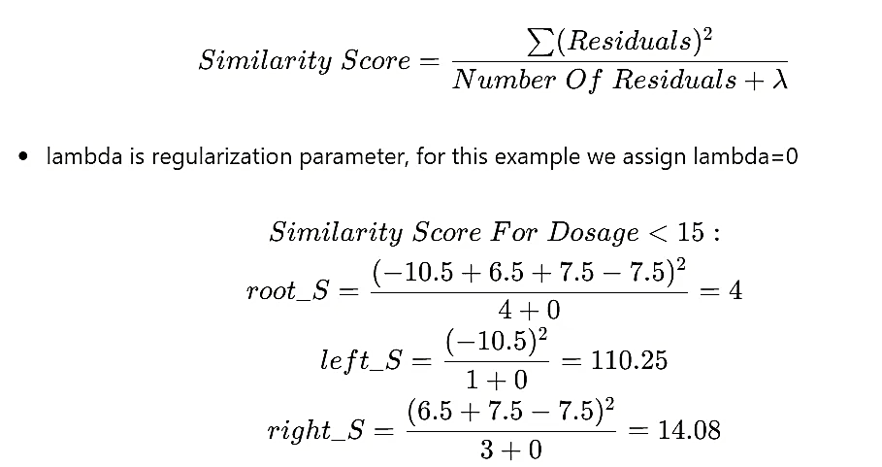
Part(b).1: Calculate Similarity Score
For the regression problem, we use the below formula to compute the similarity score

Slide 22
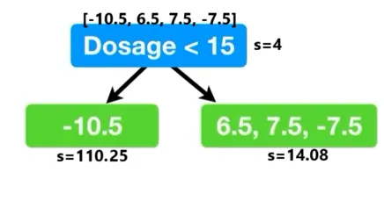
Solved problem 02(Regression)
Part(c).1: Calculate Gain (left_s + right_s — root_s)
As we selected Dosage<15 for the first branch in the tree, here we compute Gain
Gain for Dosage<15 = 110.25 + 14.08 -4 = 120.33
As we selected Dosage<15 for the first branch in the tree, we need to try different threshold values and repeat part(a), part(b), and part(c). The threshold values with the largest gain will be selected
We shift the threshold over so that it is the average of the next two observations ((20+25)/2=22.5). The Gain is 4 for Dosage<22.5. We will try the next threshold because the Gain is less than 120.33
We shift the threshold over so that it is the average of the last two observations ((25+35)/2=30). The Gain is 56.33 for Dosage< 30. Again the Gain is less than 120.33, so we will select the Dosage<15
Note We tried different values to select as threshold for first branch in the tree (e.g. Dosage<22.5 and Dosage<30 ). The threshold Dosage<15 got the largest Gain (120.33) compared to other threshold values, so we will select it for root. Dosage<15 is better at splitting the residual into clusters of similar values.
Notes:
https://medium.com/@fraidoonomarzai99/xgboost-regression-in-depth-cb2b3f623281

Slide 23
Solved problem 02(Regression)
Second(2) We check the leaf on the left and in the right to see if we can split it further:
As we have only one residual left, we can not split it further
However, we can split the 3 Residuals in the leaf on the right
So, we will perform the same operation as we did above
Part(a).2: Build Tree
First select the average of the first two observations, 20 and 25, for which we got 22.5 as the average
Then, we shifted the threshold value for the last two observations, where we got 30, the average of 25 and 35
For both we compute the Gain, the one with the largest Gain will be select
Note: The Gain for Dosage<22.5 was 28.17, while the Dosage<30 had the largest Gain. For simplicity, we will only show the steps for Dosage<30 as having the largest Gain.

Slide 24
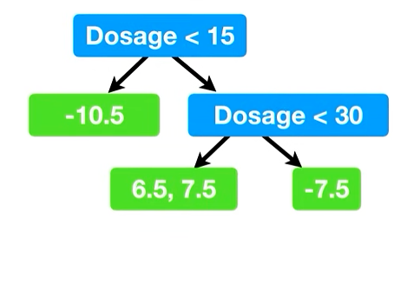
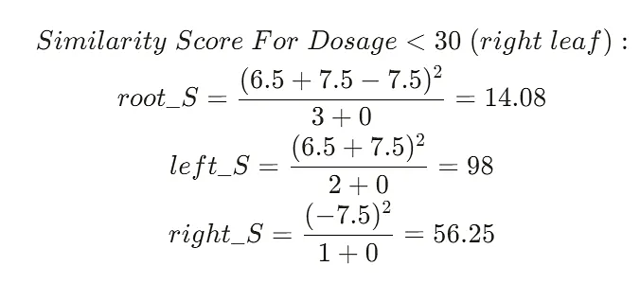
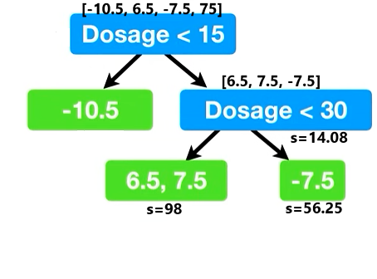
We split the tree on the right by selecting the threshold Dosage< 30
Below is our tree
Part(b).2: Calculate Similarity Score

Slide 25
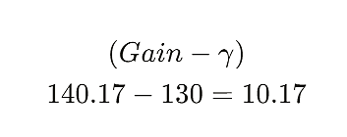
Part(c).3: Calculate Gain
Gain for threshold Dosage< 30 = 98 + 56.25–14.08 = 140.17
After trying Dosage with having different values, we got that Dosage< 30 has the largest Gain, therefore we will select it as the threshold for this branch
Note: For this example, we limited the tree depth to two levels for simplicity. So, we will not split the leaf any further. However, the default is to allow up to 6 levels.
Step4: Prune The Tree
In XGBoost, pruning is a technique used to reduce the complexity of the model by eliminating parts of the decision trees that do not contribute significantly to the model’s performance. Pruning helps prevent overfitting and enhances the model’s generalization to unseen data
We prune an XGBoost Tree based on it`s Gain values
We start by packing a number, for example, 130. XGBoost called this number gamma
We then calculate the difference between the Gain associated with the lowest branch in the tree (Gain — gamma)
If the difference between Gain and gamma is negative we will remove the branch, otherwise, we do not remove the branch (Positive)

Slide 26
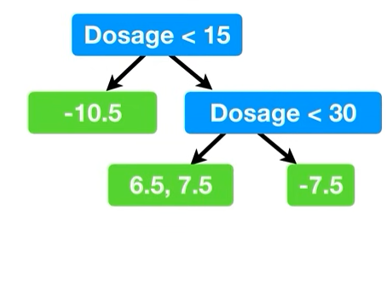
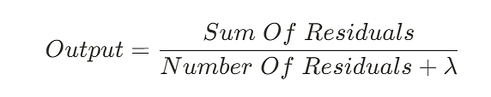
As we got positive, we will not remove the branch
Note If we compute the difference between Gain for root and gamma, the difference will be negative. We will not remove the root, because we did not remove the first branch.
Imagine, if we assign gamma=150, it will remove all the tree (because 140.17–150 is negative, and 120.33–150 is negative), and we will construct the tree again with a different lambda value (In the above example lambda=0)
So in this example imagine we select the below tree as the best one
Step5: Compute Output

Slide 27
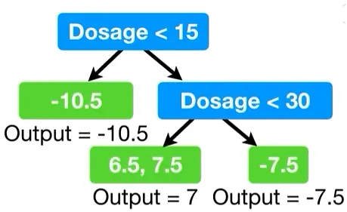
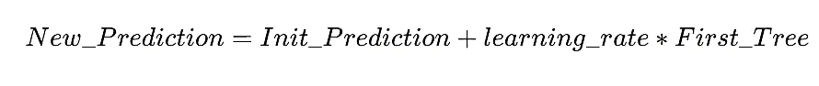
Below are our output values, and our first tree is completed!
Step6: New Prediction
Init_Prediction = 0.5
The learning rate is eta, and the default value is 0.3
Below is the prediction for the first observation

Slide 28
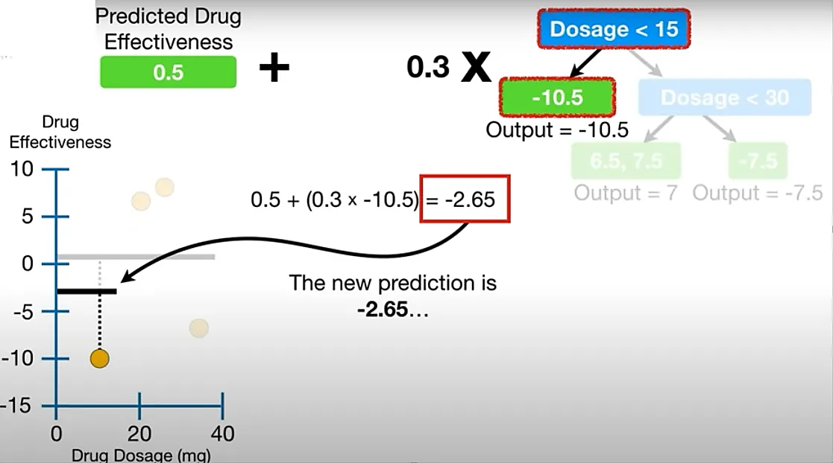
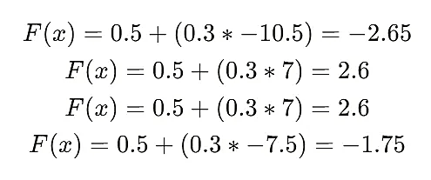

Slide 29
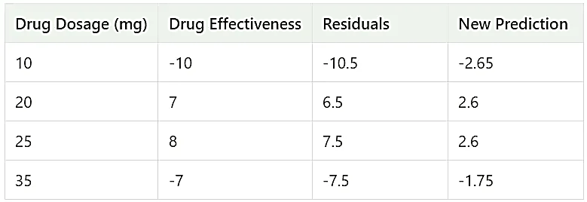
Prediction using the first tree
Next, we will build another tree with new residuals and make a prediction, we keep building trees until the residuals are super small, or we have reached the maximum number

Slide 30
Solved problem 03(Regression)
Experience | Gap | Salary
2 | Yes | 40k
2.5 | Yes | 42k
3 | No | 52K
4 | No | 60k
4.5 | No | 62k

Slide 31
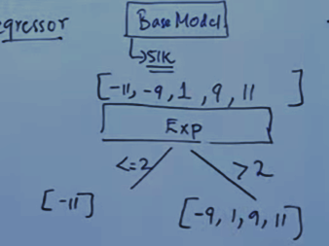
Solved problem 03(Regression)
Experience | Gap | Salary | Average Salary | Residual 1
2 | Yes | 40k | 51k | -11
2.5 | Yes | 42k | 51k | -9
3 | No | 52K | 51k | 1
4 | No | 60k | 51k | 9
4.5 | No | 62k | 51k | 11

Slide 32
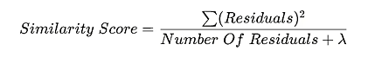
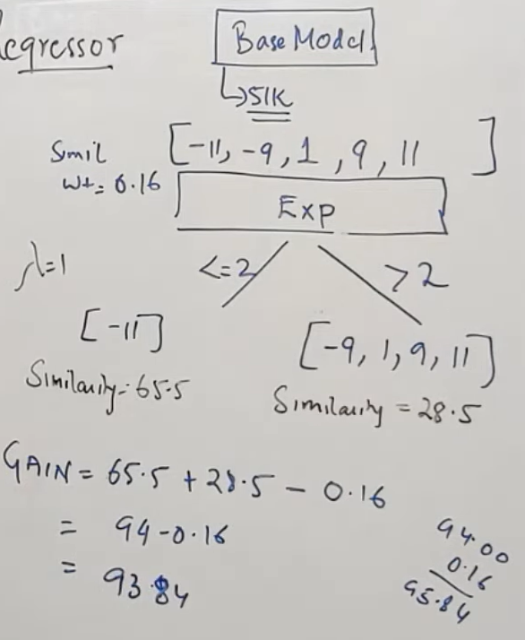
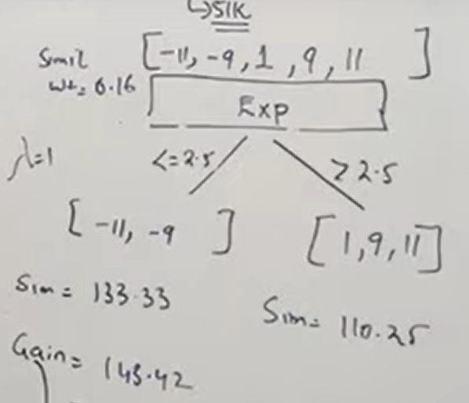
Solved problem 03(Regression)
143.42

Slide 33
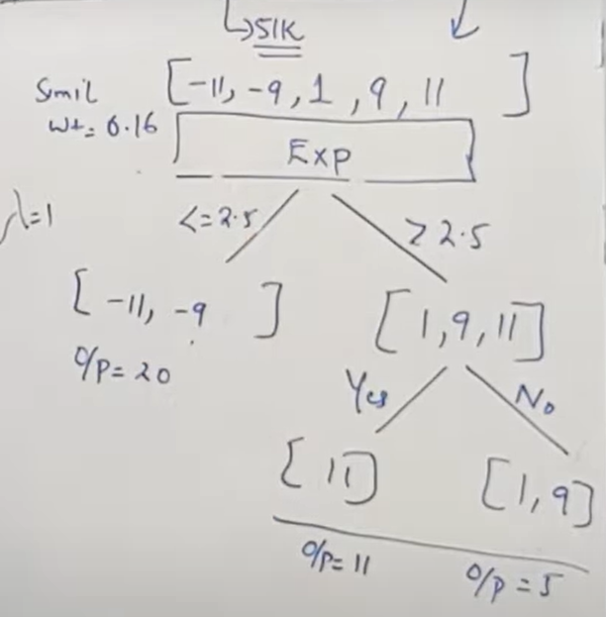
Solved problem 03(Regression)
O/P=-20/3
O/P=11/2
O/P=10/3

Slide 34
Solved problem 03(Regression)
New Prediction=51+0.5*-20/3=47.667
New Prediction=51+0.5*11/2=53.75
New Prediction=51+0.5*10/3=52.667
Residual is reducing
Experience | Gap | Salary | Average Salary | Residual 1 | New Prediction | Residual 2
2 | Yes | 40k | 51k | -11 | 47.667 | -7.667
2.5 | Yes | 42k | 51k | -9 | 47.667 | -5.667
3 | No | 52K | 51k | 1 | 52.667 | -0.667
4 | No | 60k | 51k | 9 | 52.667 | 7.333
4.5 | No | 62k | 51k | 11 | 53.75 | 8.25

Slide 35
Solved problem 01(Classification)
 | Dosage | Gender | Effect
0 | 2 | M | 0
1 | 8 | F | 1
2 | 12 | M | 1
3 | 18 | F | 0
Before starting model creation, let us define our parameters:
max_depth(maximum depth of decision tree) : 2
learning_rate : 1
gamma : 2
min_child_weight(factor which controls tree pruning): 0
reg_lambda: 0
base_score : 0.5
n_estimators : 2

Slide 36
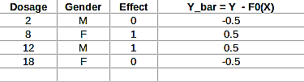
Step1: Create a base model / Initial prediction (F0(x))
This is based on base_score that we set. For binary classification problems we usually set it 0.5.
So, F0(x) = h0(x) = 0.5.
Step2: Calculate the residuals

Slide 37
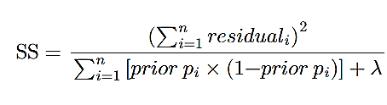
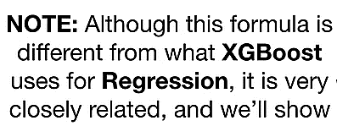
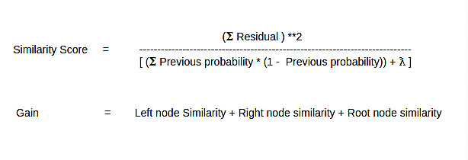
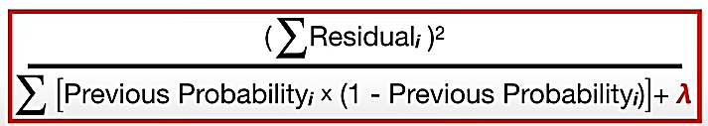
Step3 : Create a model based on residuals. This step contains multiple steps:
A: First construct all possible trees and calculate similarity and gain for each tree.
Note that We have the following equations for gain and similarity score

Slide 38
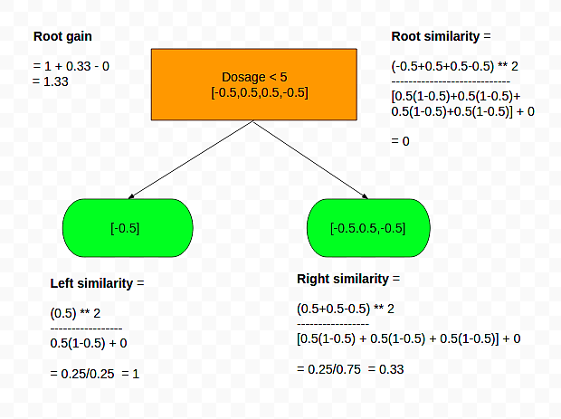
Let us create the first decision tree

Slide 39
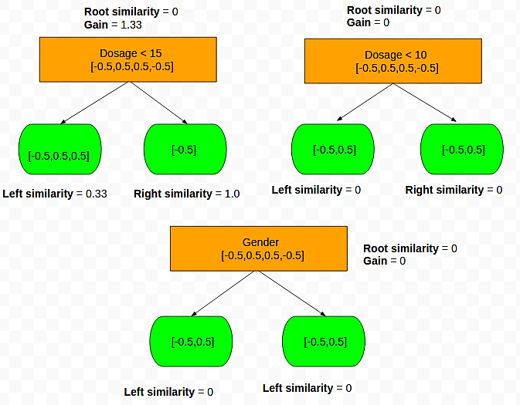
We will also calculate similarity score and gain as per above equations. Similarly calculate all possible trees.

Slide 40
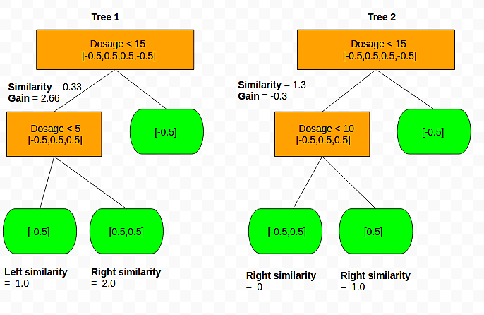
We can see that tree with dosage < 15 and dosage < 5 gives high gain value. Choose any one of them. We choose tree with dosage < 15.
B: Since we have choosen max_depth = 2, Allow tree to grow to depth of 2 in similar fashion.
Similarity =0.33
Gain=0.667
From the fig based on gain we choose Dosage < 5 as our second node (tree1) and constructed a fully grown tree (as per our max_depth =2.)

Slide 41
C: Post Pruning of tree.
Next step is pruning the tree. Here we remove portion of tree which is not usefull.
How to perform prunning?
We already defined a parameter gamma = 2. This determines how to prune the trees. Starting from the last node
If (gain - gamma) < 0:
Remove that particular node and check the same for the node just above it and continue pruning.
Else:
Do not remove that node and stop pruning.
Here we have gain = 2.66
So, gain - gamma = 2.66 - 2 = 0.66 > 0, So we don’t prune and leave as it is.
Notes:
https://www.kaggle.com/code/arunmohan003/xgboost-from-zero-to-hero

Slide 42
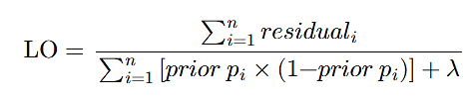
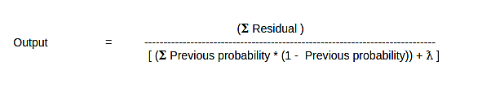
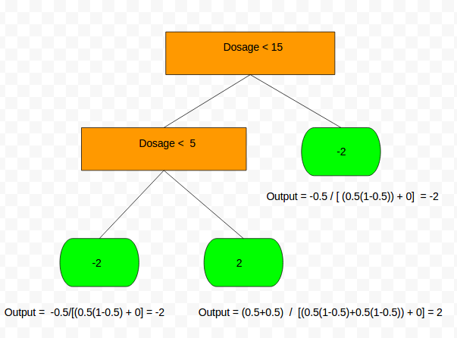
D: Calculate output value.
We have the following equation to calculate the output. Here lambda is the parameter we initialized earlier (lambda = 0)

Slide 43
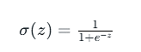
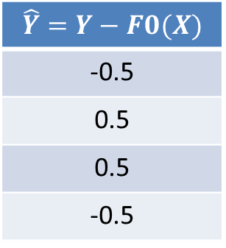

E: Calculate the probability of each prediction
For that first we need to convert our previous probability to a number.
Note: We have F0(x) as probability. To convert it to number use log(odds)
F0(x) = h0(x) = log(odds) = log(p/1-p) = log(0.5/(1-0.5)) = log(1) = 0
Now calculate new probability.
F1(X) = sigmoid ( h0(x) + learning_rate * h1(x) )
= sigmoid (0+1*-2)= sigmoid (-2)=$\frac{1}{1+e^{−(−2)}}=\frac{1}{1+{e }^{2}}=0.11$
Again sigmoid (2)=$\frac{1}{1+e^{−2)}}=0.88$
SL. | Dosage | Gender | Effect=Y
0 | 2 | M | 0
1 | 8 | F | 1
2 | 12 | M | 1
3 | 18 | F | 0
h0(x)
0.5
0.5
0.5
0.5
$$\hat{Y}=Y−F0(X)$$
-0.5
0.5
0.5
-0.5
h0(x) =log(odds)
0
0
0
0

Slide 44

Step 4.
Repeat step 2 and Step 3 until required number of models are build.
Here we have n_estimators = 2. So we stop here with the tree.
Notes:
https://medium.com/@fraidoonomarzai99/xgboost-classification-in-depth-979f11ef4bf9

Slide 45
Thank You

